Slide 1
Level Up Your Learning
Step into a personalized learning experience that’s built to grow with your team.

Slide 2
What’s in it for you and your team?
Go1 gives you instant access to more than 80,000 learning resources from the world’s best content providers.
Sourced, aggregated, and curated to help you stay compliant and at the top of your game.

Slide 3
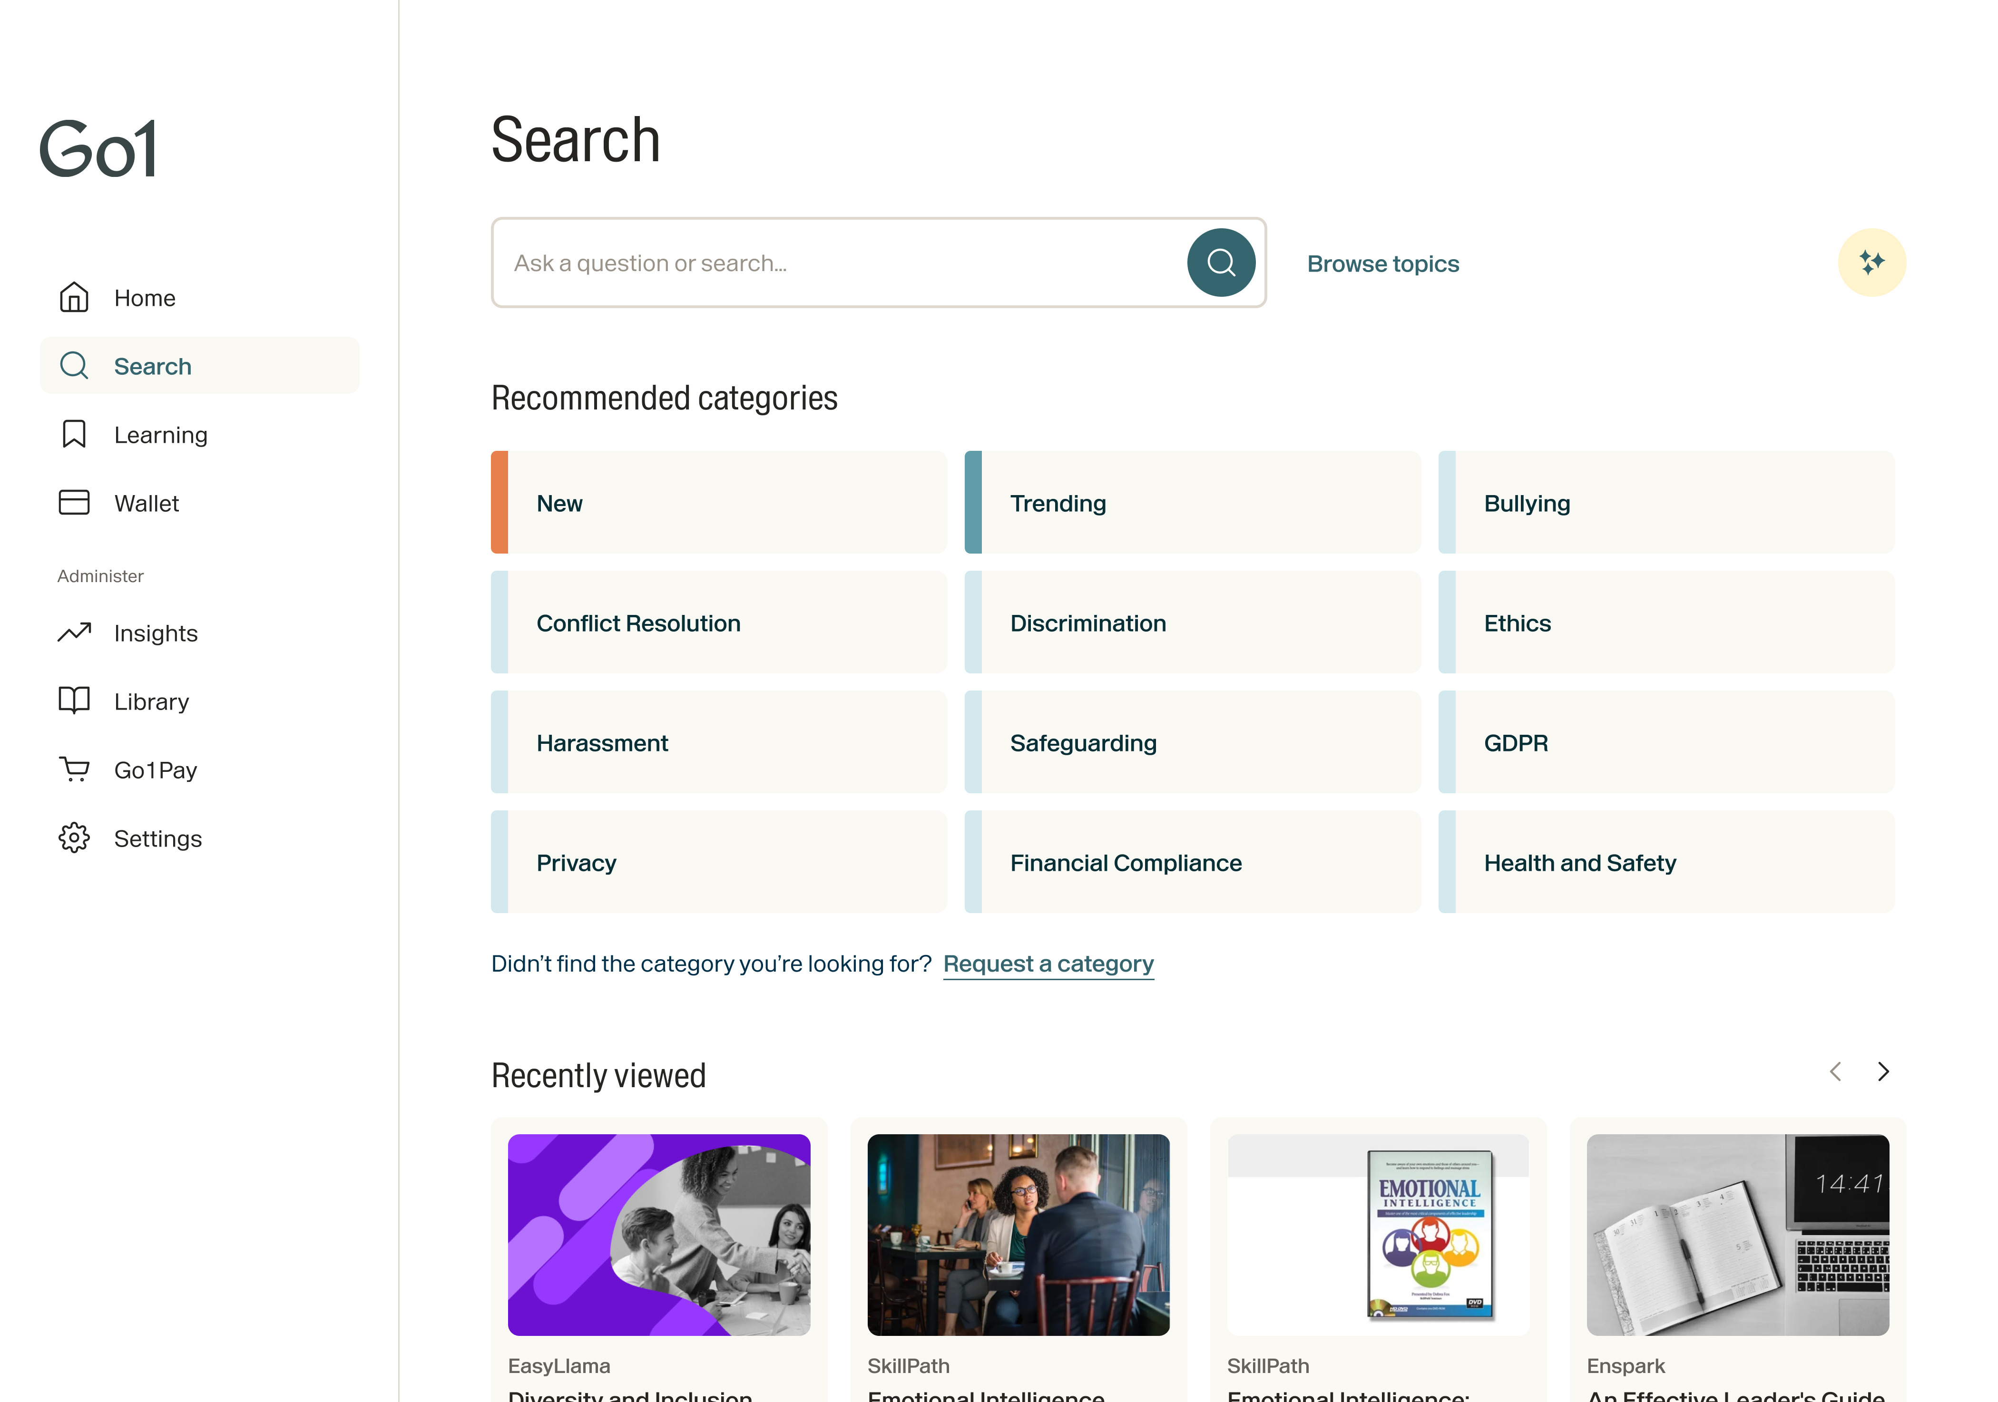
Keep your team ahead of the game with quality learning content for every role, at every level
Managers and Supervisors
Admin Staff
A solution aligned to your team’s needs.
Sales
Customer Service
Skilled Labor Staff
Operations
Developer
Human Resources
+ More
Go1 Platform

Slide 4
Go1 learners are proven to jump higher and grow faster.
Consistent and relevant learning is a catalyst for career, and organizational success.
Where will Go1 learning take you and your team? The possibilities are endless.

Slide 5
Ready to level up?

Slide 6
Once you’ve registered, log in to your team’s LMS or via the Go1 portal for instant access.
Leverage ready to go
Create your own
Popular topic learning playlists
Learning playlists
Content Partner Playlists
Company awards

Slide 7
Fulfill the needs and skill gaps of every learner
Find the topic
Finance
Communication
Business Skills
Health & Wellbeing
Management
Sales
IT Skills
Project Management
Marketing & Advertising
Health & Safety
Personal Development
Customer Service
Compliance
Leadership
Human Resources
More
Select the format
Interactive
Text
Quiz
Video
Award
Course
Audio
More
Choose the length
Short
1-10 min
Medium 30-60 min
Long 60+ min

Slide 8
Your team can own their wins and targets with Awards
Create targets to ensure completion of all components
Set learner expectations by setting due dates
Add previously completed external records
Add your own-created content alongside Go1 courses

Slide 9
Tracking your team’s learning journey has never been easier
Save time and effectively manage your team’s learning journey easily in one convenient place.
Easy Learning and Reporting
Single Sign-On (SSO)
One Way Data-Feed
Centrally track progress and completion data
Configure reports to meet your needs
Always report in real-time
Simple to share with everyone inside (and outside) the Go1 platform
Re-assign learning to users in one click
Strengthened security
Improved usability for all employees
Seamless user access between systems
Streamline employee onboarding
User data integrity across systems
Regularly refreshed to reflect changes to data

Slide 10
Create contextual learning in minutes
Find high quality, relevant courses. Save courses for later. Personalise your recommendations.
Create organization-specific learning
Support blended learning via Events
Test knowledge with in-build assessment tool

Slide 11
Learn and grow as a team
Access discussion groups for common topics and team members.
Product: This is mygo1 functionality, don't we want to only feature Go1 Learn since we are in the process of migrating all learners over to it? It's unknown whether discussion groups is a feature that will be carried over at this point.

Slide 12
Teams
Go1 with the flow
Discover and launch learning directly within Teams
Collaboratively build learning pathways
A familiar experience for users
Learn together in a virtual classroom
Consistent learning records

Slide 13
Just 2 hours/week
Most learners see real growth by committing just two hours per week. No need to master 10,000 hours—small, consistent efforts lead to big progress.
Start tracking your learning time and celebrating wins with your team. Every little step is a reason to celebrate.

Slide 14
Our path to unlock your potential
Personalise your experience
Share what we’ve learned in our groups
Week 2
Structure learning pathway
Final Q&A with Go1 CSM
Week 4
Week 1
Week 6
Week 8
Week 3
Registration and exploration
Curate your learning pathway
Week 5
Week 7
Enroll in your next course
Learning pathway review with team lead

Slide 15
Win the learning game!

