Slide 1
Ready, Set, Go1
Level up with your new ecosystem of personalised digital learning, curated just for you.

Slide 2
What’s in it for you?
Go1 gives you instant access to more than 80,000 learning resources from the world’s best content providers.
Sourced, aggregated, and curated to help you stay compliant and at the top of your game.

Slide 3
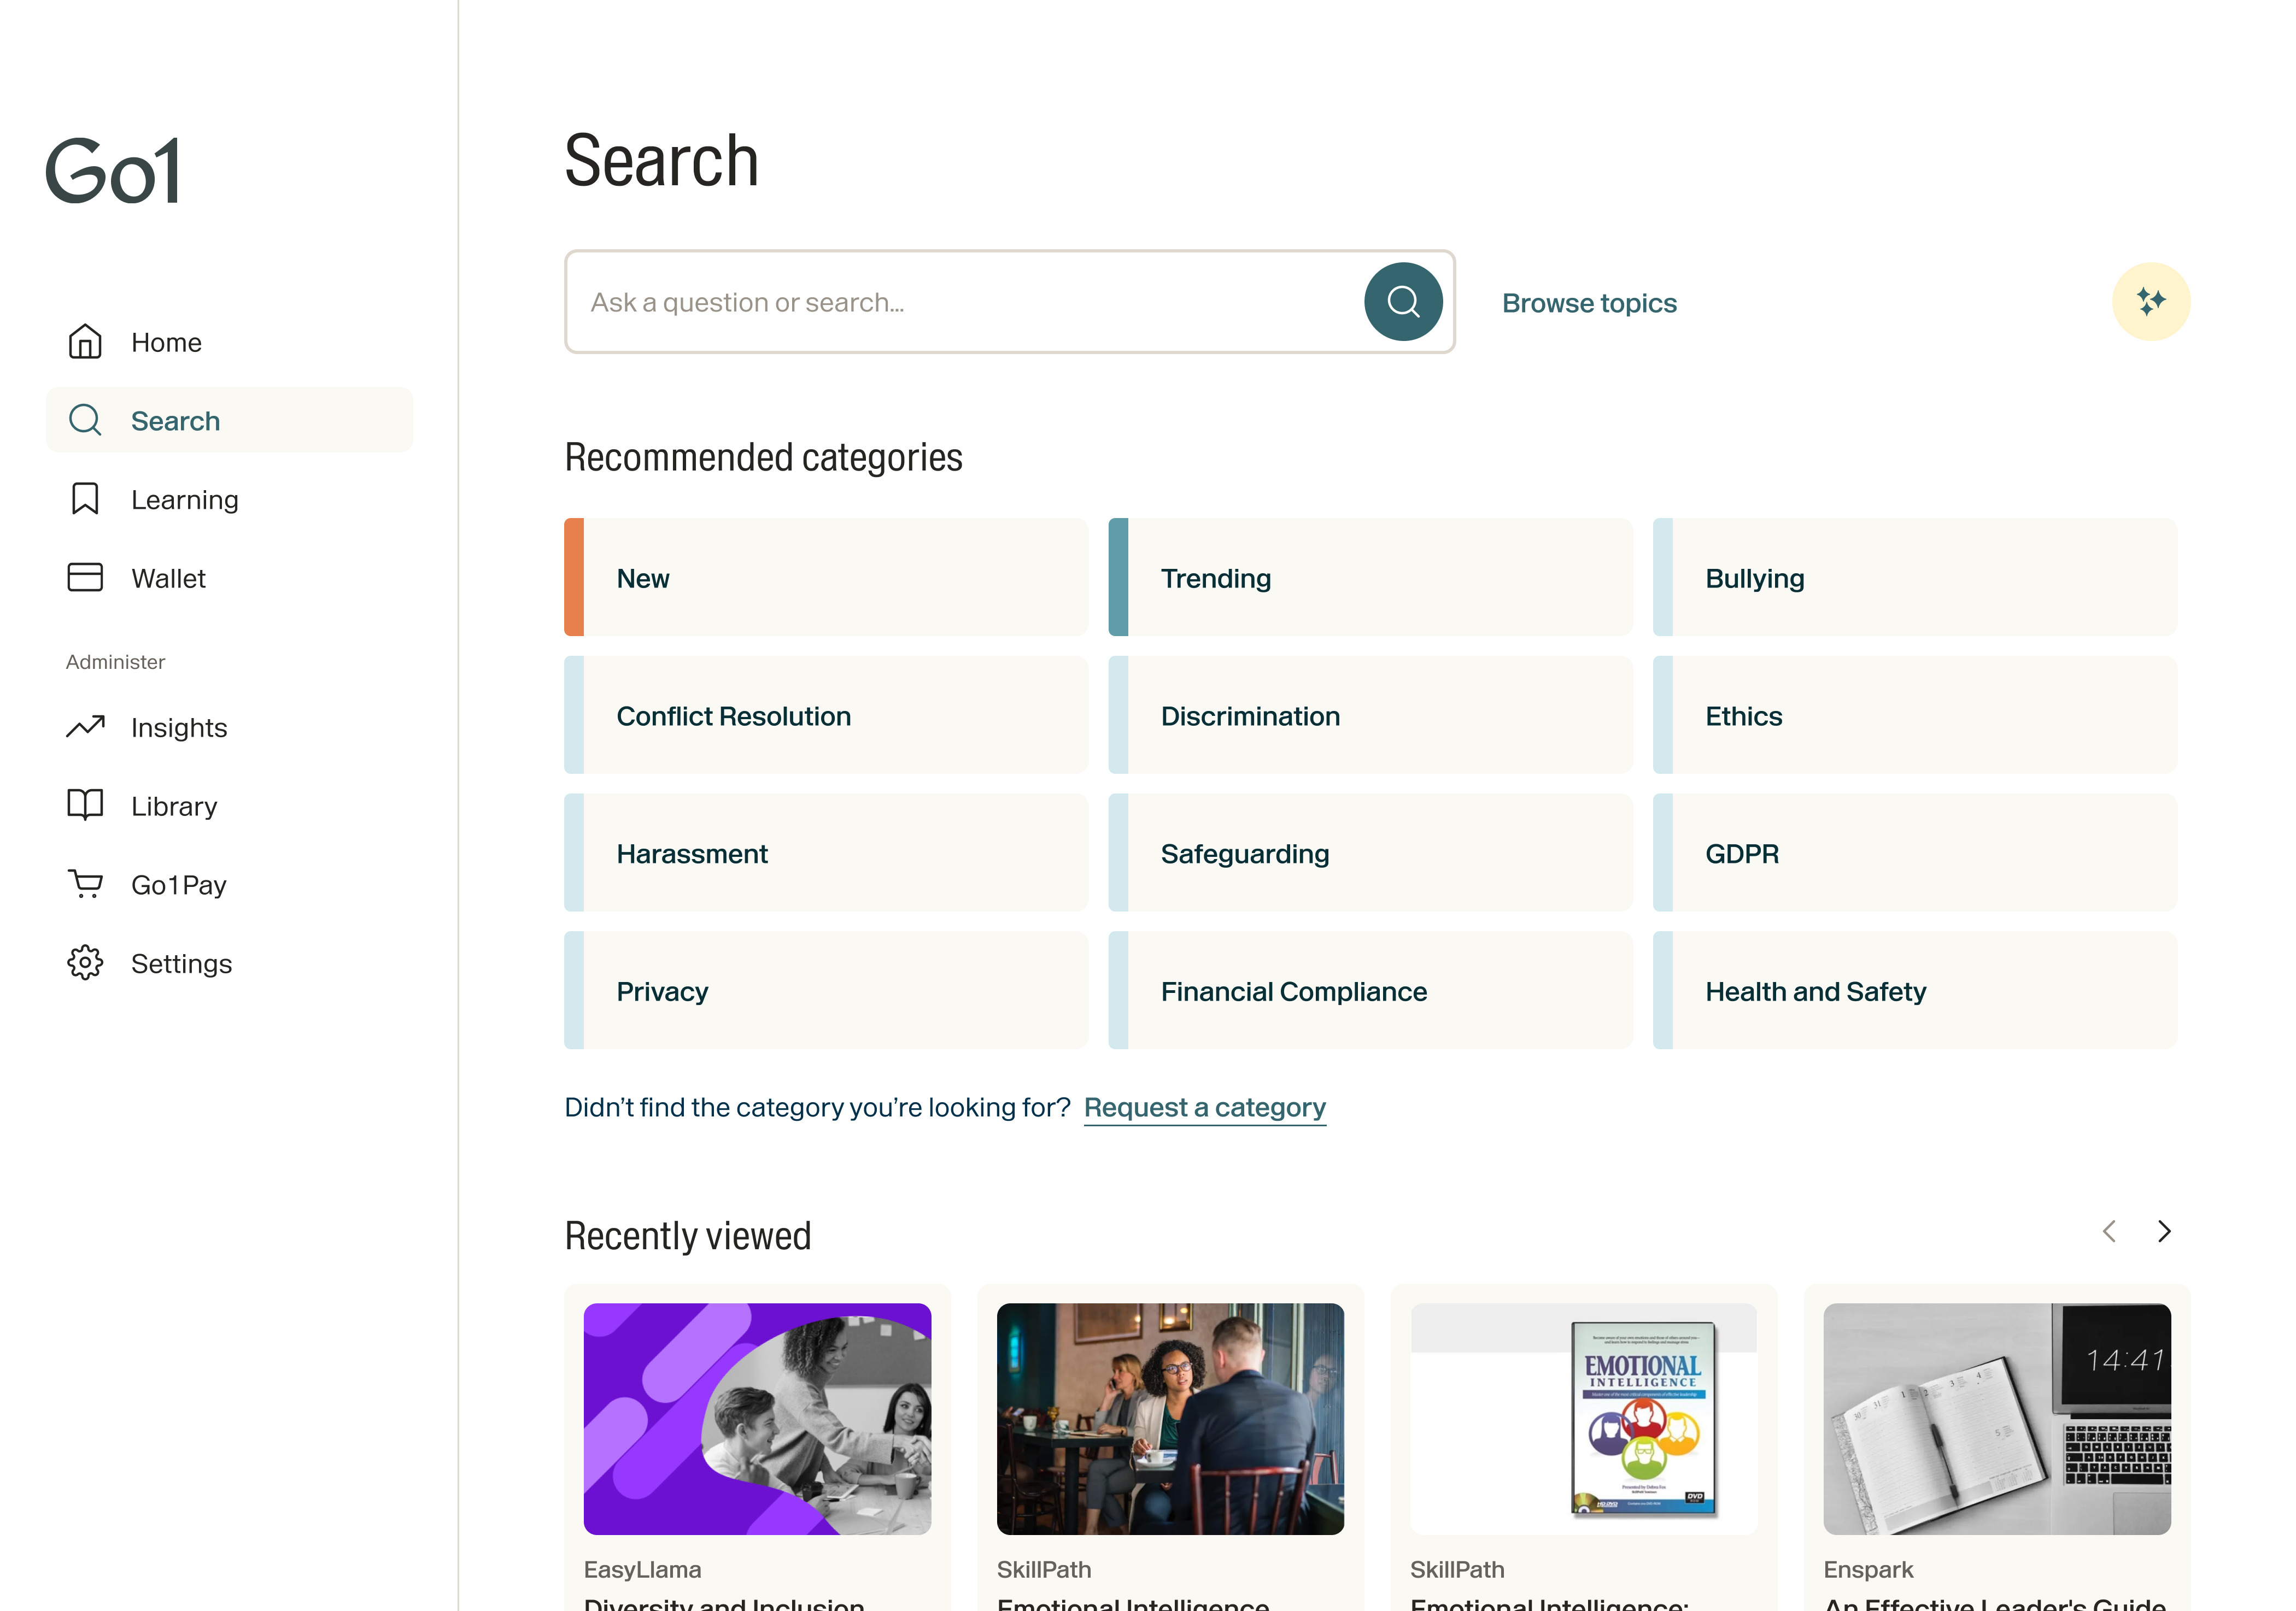
Stay ahead of the game with access to quality learning content for every role, at every level
Managers and Supervisors
Admin Staff
Whatever your role or ambition, Go1 fast tracks your growth through learning.
Sales
Customer Service
Skilled Labor Staff
Operations
Developer
Human Resources
+ More
Go1 Platform

Slide 4
Go1 learners are proven to jump higher and grow faster
It’s no secret that constant learning is the highway to success. Where would you like to go in your career?
Go1 is our investment in you and your success. Where you go from here is up to you, and the possibilities are endless.

Slide 5
Ready to level up?

Slide 6
Once you’ve registered, log in to your team’s LMS or via the Go1 portal for instant access.
Leverage ready-to-go
Create your own
Popular topic learning playlists
Learning playlists
Content Partner Playlists
Company awards

Slide 7
Self-directed learning for any style.
Find the topic
Finance
Communication
Business Skills
Health & Wellbeing
Management
Sales
IT Skills
Project Management
Marketing & Advertising
Health & Safety
Personal Development
Customer Service
Compliance
Leadership
Human Resources
More
Select the format
Interactive
Text
Quiz
Video
Award
Course
Audio
More
Choose the length
Short
1-10 min
Medium 30-60 min
Long 60+ min

Slide 8
Easily find what’s relevant to you
Find high-quality, relevant courses. Save courses for later. Personalise your recommendations.

Slide 9
A little learning goes a long way
You don’t need to spend 10,000 hours to start growing. Most learners see a marked improvement in as little as 2 hours per week.
Track your progress and share your achievements with the team. Now that’s worth celebrating!

Slide 10
Our path to help you unlock the world of learning
Personalise your experience
Share what we’ve learned in our groups
Week 2
Structure learning pathway
Final Q&A with Go1 CSM
Week 4
Week 1
Week 6
Week 8
Week 3
Registration and exploration
Curate your learning pathway
Week 5
Week 7
Enroll in your next course
Learning pathway review with team lead

Slide 11
Win the learning game!

